Slide 1


Machine Learning and Statistics:
Thomas Wiecki, PhD
VP of Data Science / Head of Research
Quantopian Inc.
@twiecki

Slide 2
Disclaimer
This presentation is for informational purposes only and does not constitute an offer to sell, a solicitation to buy, or a recommendation for any security; nor does it constitute an offer to provide investment advisory or other services by Quantopian, Inc. ("Quantopian"). Nothing contained herein constitutes investment advice or offers any opinion with respect to the suitability of any security, and any views expressed herein should not be taken as advice to buy, sell, or hold any security or as an endorsement of any security or company. In preparing the information contained herein, Quantopian, Inc. has not taken into account the investment needs, objectives, and financial circumstances of any particular investor. Any views expressed and data illustrated herein were prepared based upon information, believed to be reliable, available to Quantopian, Inc. at the time of publication. Quantopian makes no guarantees as to their accuracy or completeness. All information is subject to change and may quickly become unreliable for various reasons, including changes in market conditions or economic circumstances.

Slide 3

Is machine learning just statistics?

Slide 4


Our protagonists
Statistical Rick
Machine Learning Morty
Studied applied math
Proves asymptotic behavior of models
Thinks carefully about assumptions
Models often linear with few parameters
Model results can be understood
Large data sets cause problems
Uses R and Python statsmodels
Studied computer science
Optimizes prediction accuracy of models
Thinks carefully about overfitting
Models non-linear with many parameters
Models are often black-box
Requires large data sets
Uses TensorFlow and scikit-learn

Slide 5
Proposition
Not enough cross-talk between machine learning and statistics
Methods often complementary and can be combined to solve complex problems neither alone can solve
In this talk, Rick & Morty, will try to cooperate to solve increasingly complex problems

Slide 6
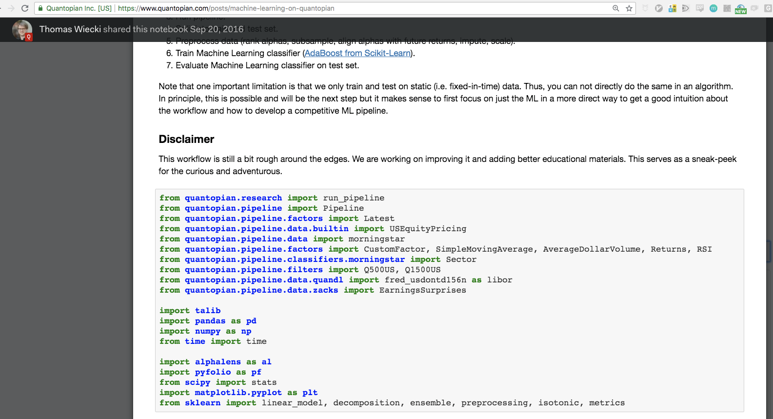
Quantopian: Algorithmic Trading Platform
Jupyter Notebook + 14 years of finance data
Community with >200k members
Lot's of training materials
Trading competition with cash prizes
License your strategy to Quantopian and earn share of the profits
Free to use & you keep your intellectual property

Slide 7
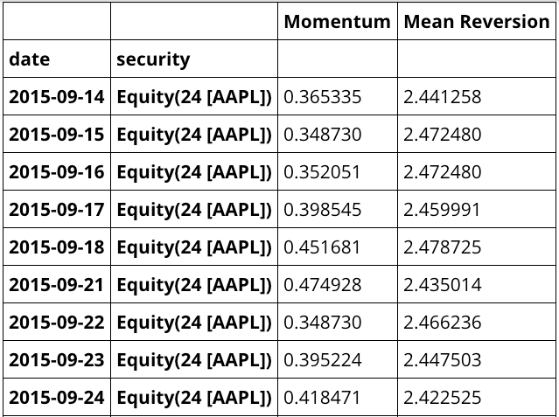
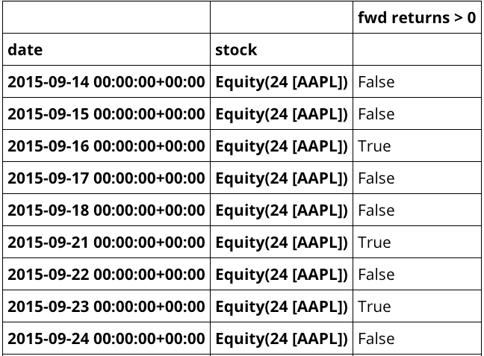
Data after preprocessing on Quantopian
Features
Labels

Slide 8
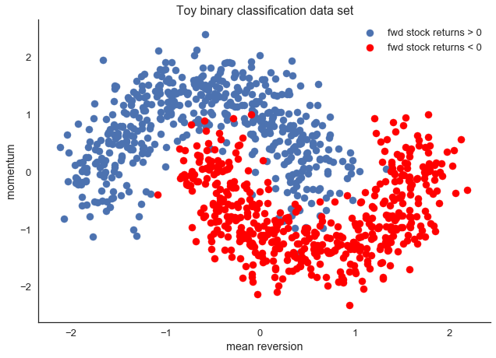
Simulated data: finance domain
Every point refers to a single day

Slide 9
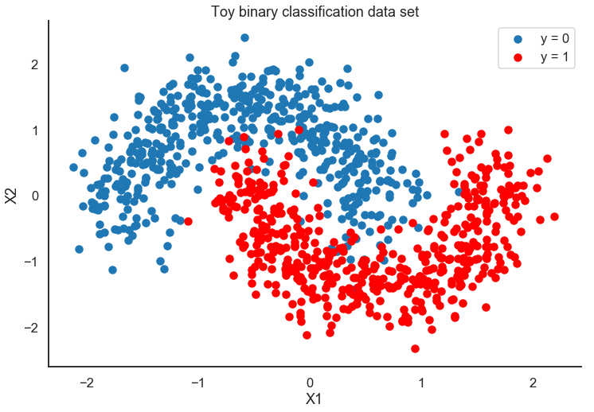
Simulated data: general domain

Slide 10
How do our protagonists attack this problem?
ML Morty: Well that's a typical ML classification problem if I've ever seen one.
Stats Rick: You probably will think as a statistician I won't be able to solve this, but we can also classify -- it's called logistic regression!
ML Morty: I trust you can, but there is a bit more to it than you might think. I'd be happy to help you but we need a tool that gives us enough flexibility to incorporate our perspectives.
Stats Rick: I heard about this package called PyMC3 that all the cool kids use!

Slide 11

Probabilistic Programming framework for Python, FOSS
Specify arbitrary models in code by plugging probability distributions into each other
Intuitive model specification syntax
For example: x ~ N(0,1) translates to x = Normal('x', 0, 1)
Inference Button: Automatic and powerful inference for any model
Sampling algorithms (MCMC): More accurate, but slower
Variational inference (ADVI): Less accurate, but much faster
Thin layer on top of Theano (deep learning library like TensorFlow):
Computation optimization and dynamic C and GPU compilation

Slide 12

Logistic regression
Perceptron
X = [X1, X2] # data
W = [W1, W2] # coeffs
linear = dot(X, W)
prob = sigmoid(linear)
Y ~ Bernoulli(prob)
X1
W1
sigm(XW)
Y
X2
W2
We just call this a perceptron, but you need regularization to make this really work.
Good point, we can include that too: priors!

Slide 13
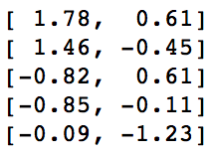
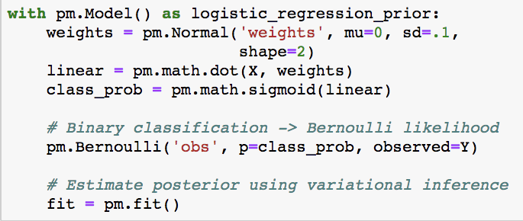
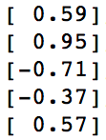
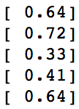
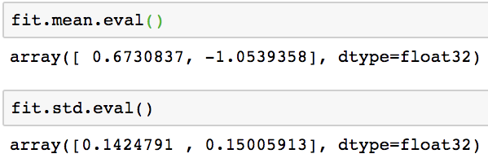
Bayesian perceptron
So far that's just two lines of scikit-learn code!
Similar to maximum likelihood
Uncertainty estimate!

Slide 14
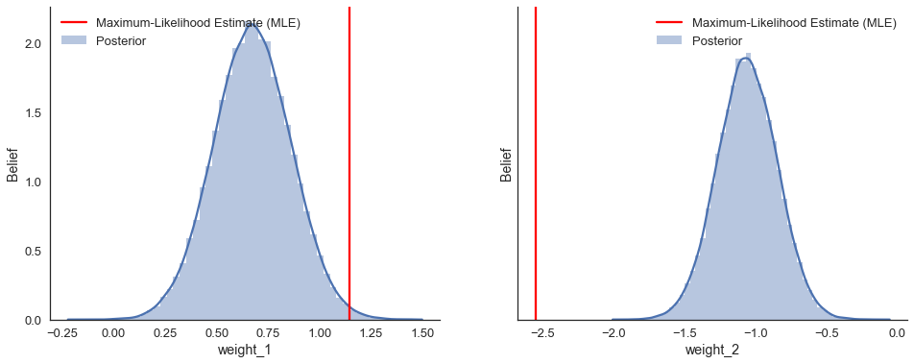
Posteriors represent ensemble of solutions

Slide 15
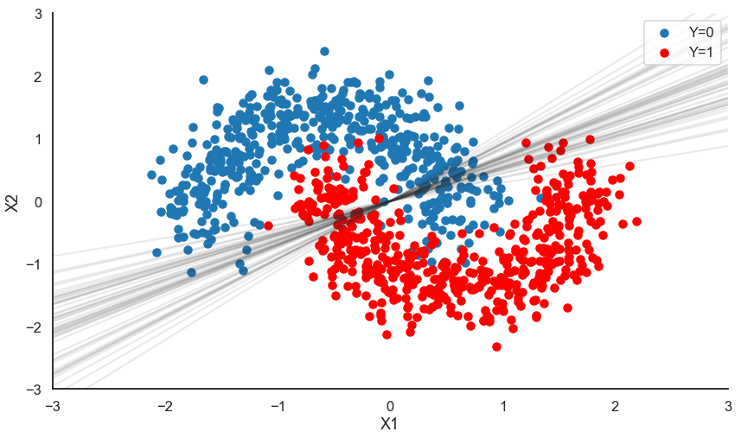
Ensemble of decision boundaries

Slide 16
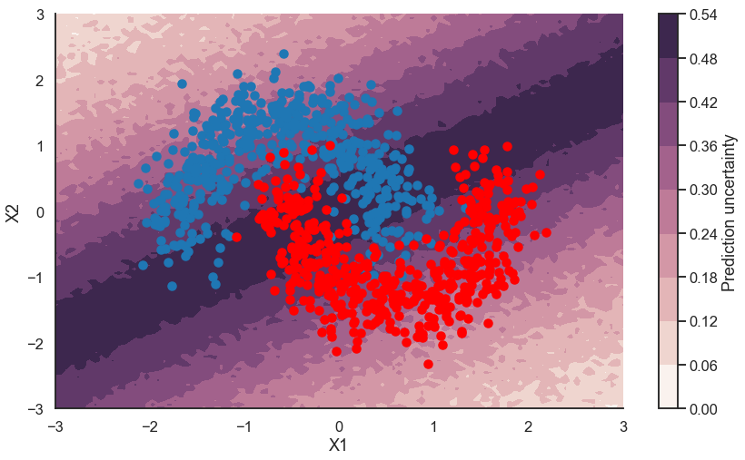
Uncertainty in each prediction

Slide 17
Stats Rick: Boom -- you can't do that with scikit-learn!
ML Morty: I guess, but what is it with you statisticians and your linear models? The world is complex! In ML we actually extended the idea of a linear perceptron to a neural network which is great at learning non-linearities.

Slide 18
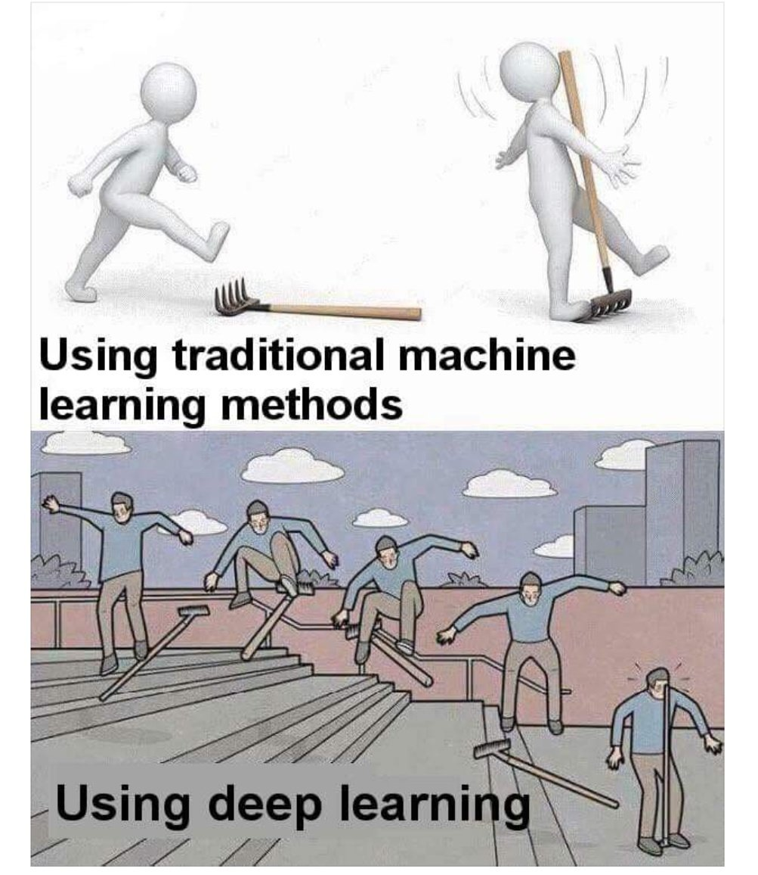
What is an Artificial Neural Network?
Stack perceptrons vertically and horizontally.
1st hidden
layer of
perceptrons
2nd hidden
layer of
perceptrons
X1
Y
X2

Slide 19
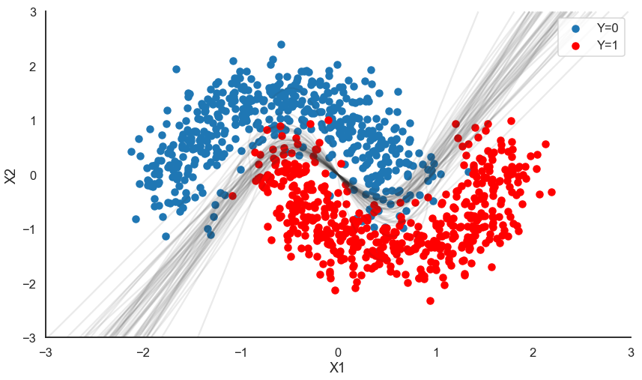
Learning non-linear decision boundaries
https://twiecki.github.io/blog/2016/06/01/bayesian-deep-learning/

Slide 20
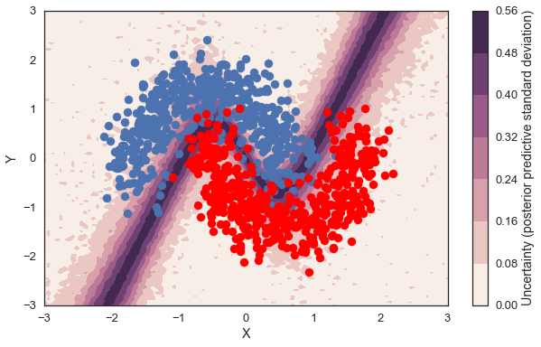
Uncertainty in each prediction
https://twiecki.github.io/blog/2016/06/01/bayesian-deep-learning/

Slide 21
Tackling nested data

Slide 22
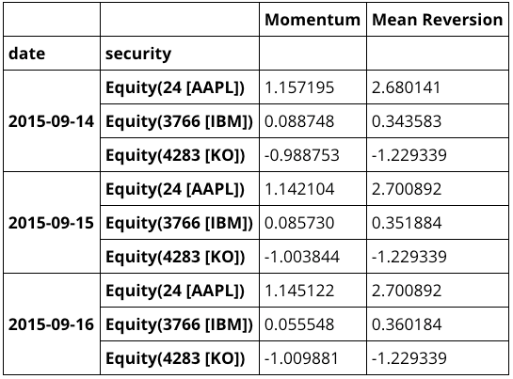
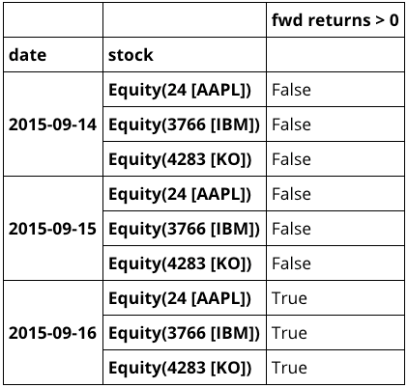
What if our data is nested?

Slide 23
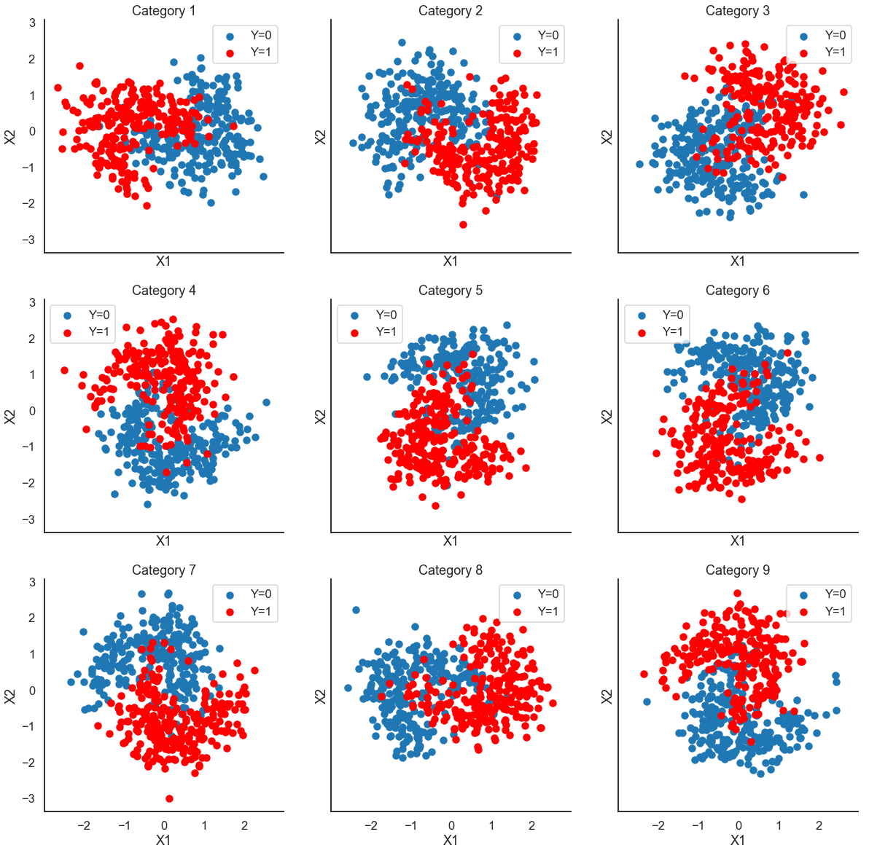
Groups from same distribution, randomly rotated

Slide 24
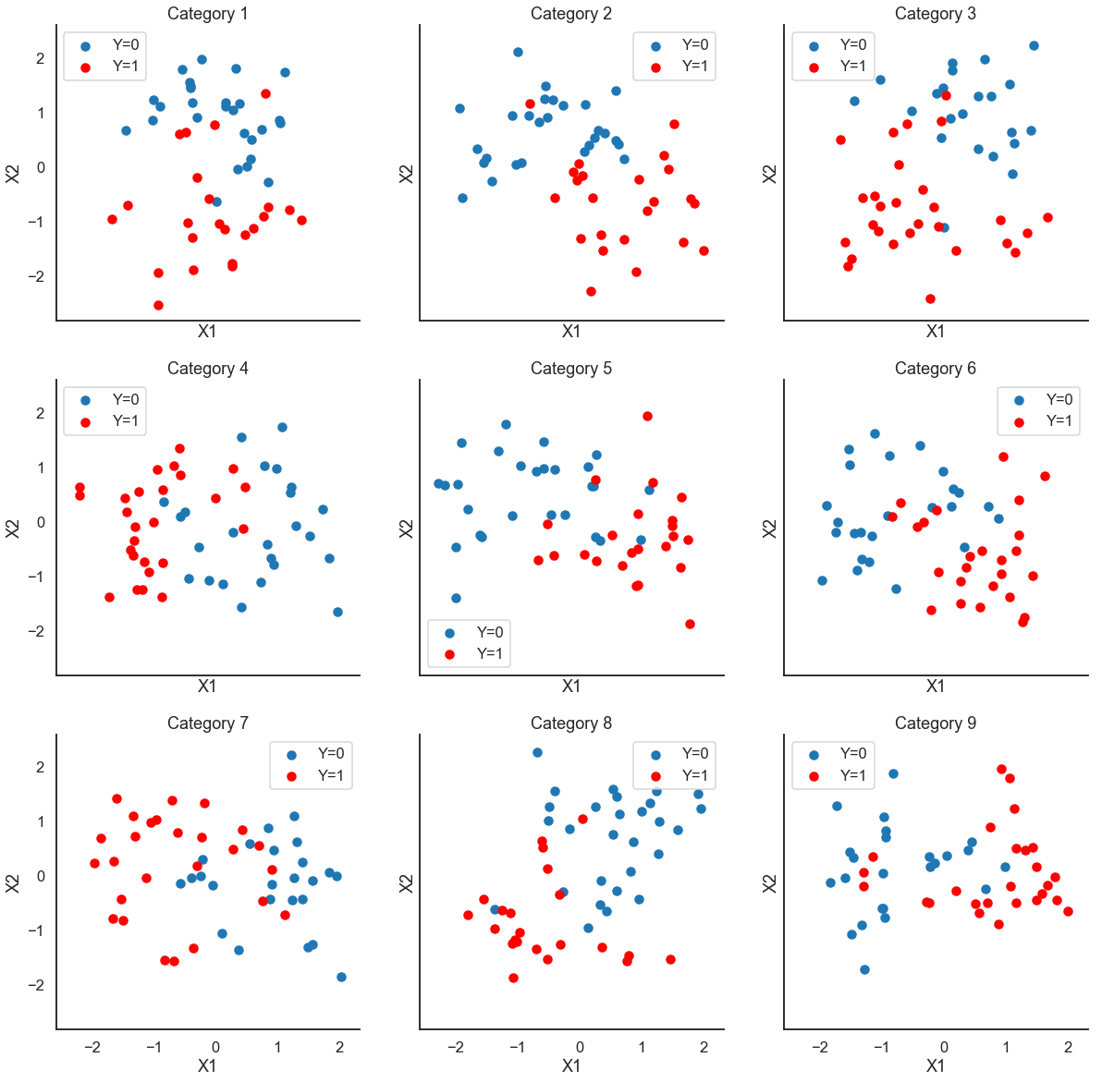
Making it challenging: only 50 data points per group

Slide 25
ML Morty: Are you kidding me? In ML we call this multi-task transfer learning and it's far from solved… My only idea is to train a separate neural network on every stock.
Stats Rick: But then we'd have to fit and evaluate N models. Mo' models, mo' problems. Also, 50 data points is not a lot but let's give it a try.

Slide 26
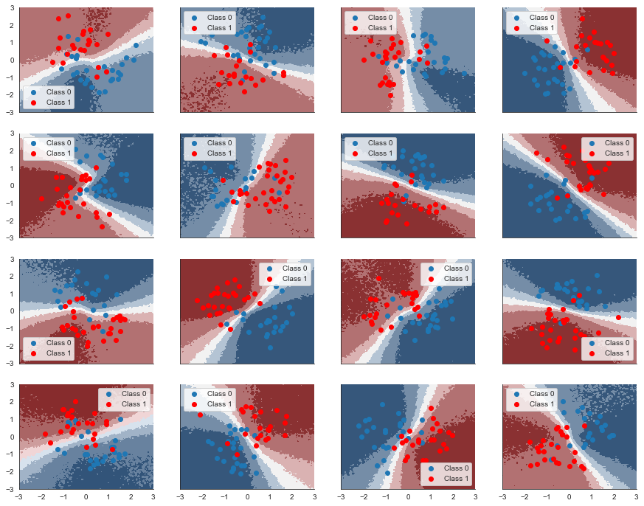
Not enough data to fit non-linearity

Slide 27
Stats Rick: That didn't really work. I told you it's not enough data.
ML Morty: I guess you were right. Do you have a better idea?
Stats Rick: In statistics we usually build hierarchical models if we encounter nested data. That way we can learn differences and similarities between stocks simultaneously.
ML Morty: What?!
Stats Rick: Let me explain...

Slide 28
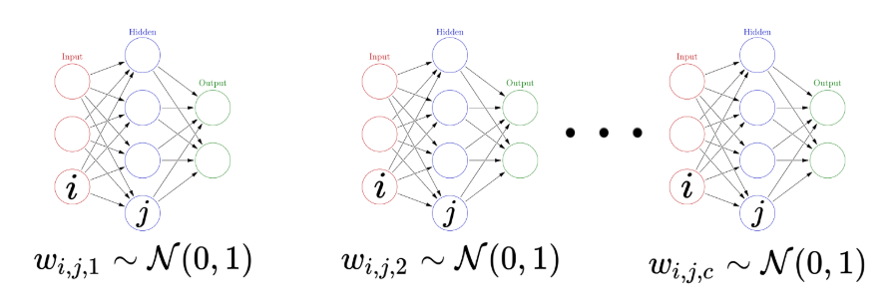
Estimating separate neural networks for each group
https://twiecki.github.io/blog/2018/08/13/hierarchical_bayesian_neural_network/

Slide 29
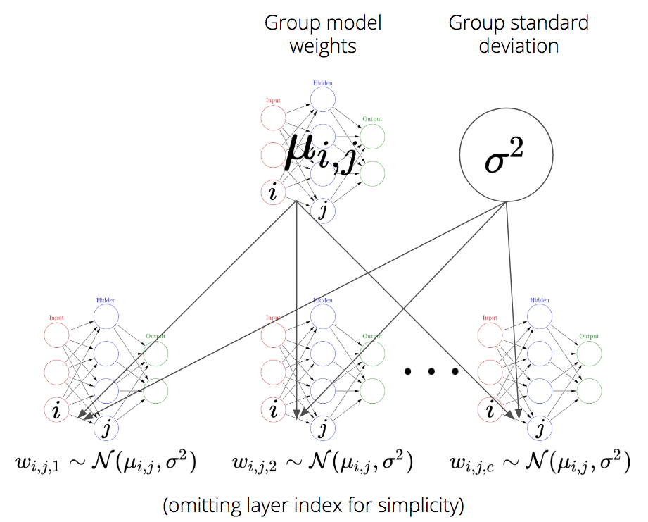
Incorporating hierarchical structure into model
https://twiecki.github.io/blog/2018/08/13/hierarchical_bayesian_neural_network/

Slide 30
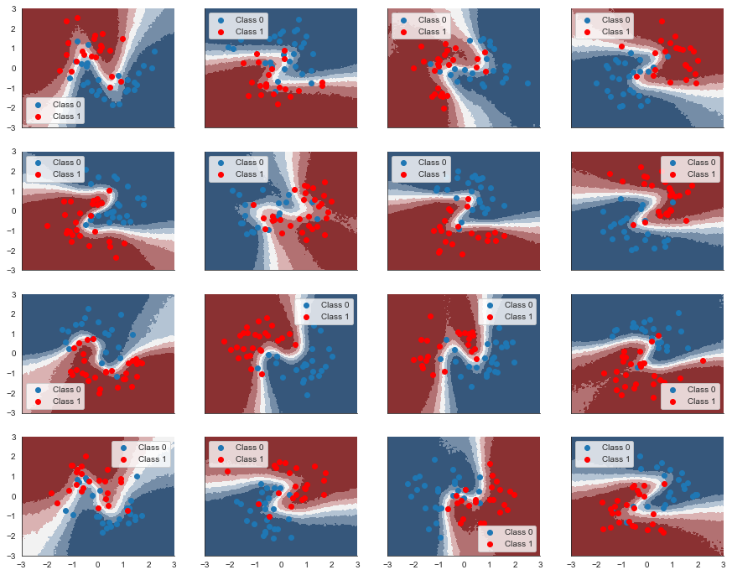
Hierarchical model exploits higher-order structure
https://twiecki.github.io/blog/2018/08/13/hierarchical_bayesian_neural_network/

Slide 31


Slide 32
Bridging machine learning and statistics
Machine Learning
Conscious of overfitting: Regularization (penalty -> priors)
Not everything is linear: neural networks powerful non-linear approximators
Deep Learning frameworks (Theano, TensorFlow) are powerful frameworks for all kinds of computation, like Bayesian statistics (PyMC3)
Statistics
Find all candidate solutions (Bayesian posterior), instead of just one (maximum likelihood)
Uncertainty in predictions
Novel methods to advance deep learning like hierarchical modeling

Slide 33

Further reading
https://www.quantopian.com
@twiecki
https://docs.pymc.io
Bayesian Deep Learning: https://twiecki.github.io/blog/2016/06/01/bayesian-deep-learning/
The Best Of Both Worlds: Hierarchical Linear Regression in PyMC3: https://twiecki.github.io/blog/2014/03/17/bayesian-glms-3/
Hierarchical Bayesian Neural Networks with Informative Priors: https://twiecki.github.io/blog/2018/08/13/hierarchical_bayesian_neural_network/

Slide 34
Disclaimer
This presentation is for informational purposes only and does not constitute an offer to sell, a solicitation to buy, or a recommendation for any security; nor does it constitute an offer to provide investment advisory or other services by Quantopian, Inc. ("Quantopian"). Nothing contained herein constitutes investment advice or offers any opinion with respect to the suitability of any security, and any views expressed herein should not be taken as advice to buy, sell, or hold any security or as an endorsement of any security or company. In preparing the information contained herein, Quantopian, Inc. has not taken into account the investment needs, objectives, and financial circumstances of any particular investor. Any views expressed and data illustrated herein were prepared based upon information, believed to be reliable, available to Quantopian, Inc. at the time of publication. Quantopian makes no guarantees as to their accuracy or completeness. All information is subject to change and may quickly become unreliable for various reasons, including changes in market conditions or economic circumstances.

Slide 35
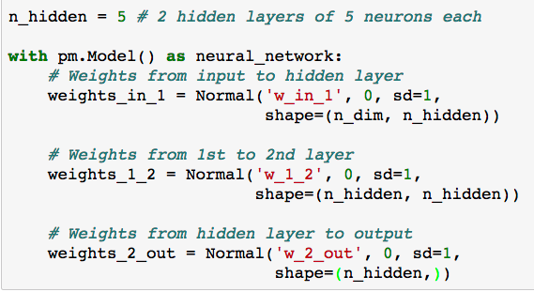
Bayesian Neural Network: Priors
https://twiecki.github.io/blog/2016/06/01/bayesian-deep-learning/

Slide 36
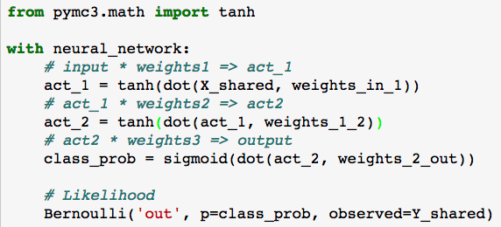
Bayesian Neural Network: Architecture
https://twiecki.github.io/blog/2016/06/01/bayesian-deep-learning/

Slide 37
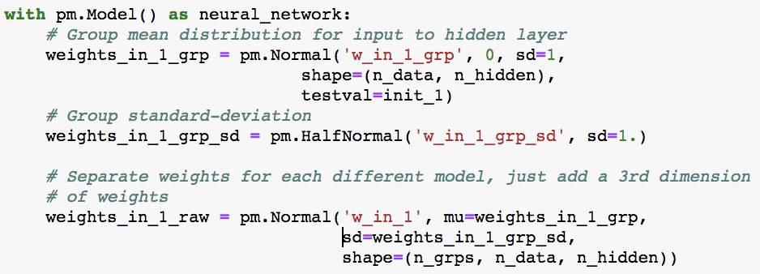
Hierarchical Bayesian Neural Network in PyMC3
https://twiecki.github.io/blog/2018/08/13/hierarchical_bayesian_neural_network/

